Slide 1


Applied Sciences
PT4050 and PT7001
Muscle Physiology Part 2
Chris Chamberlin and Dr Ben Hunter
c.chamberlin@londonmet.ac.uk

Slide 2
Learning Outcomes
Smooth muscle
  Structure and innervation
Three muscle types
  Skeletal, smooth, cardiac
Contraction regulation in smooth and skeletal muscle
Energy supply

Slide 3
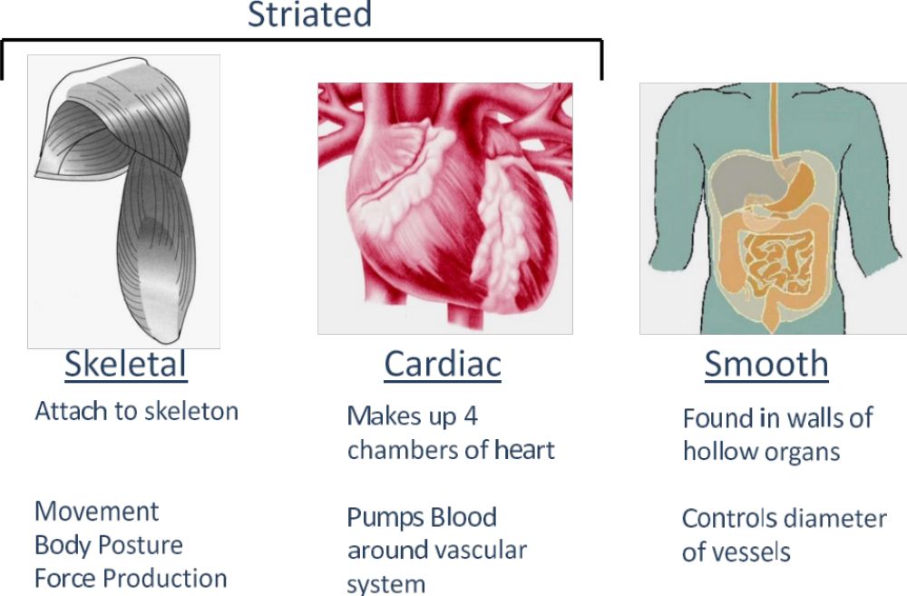
Types of Muscle

Slide 4
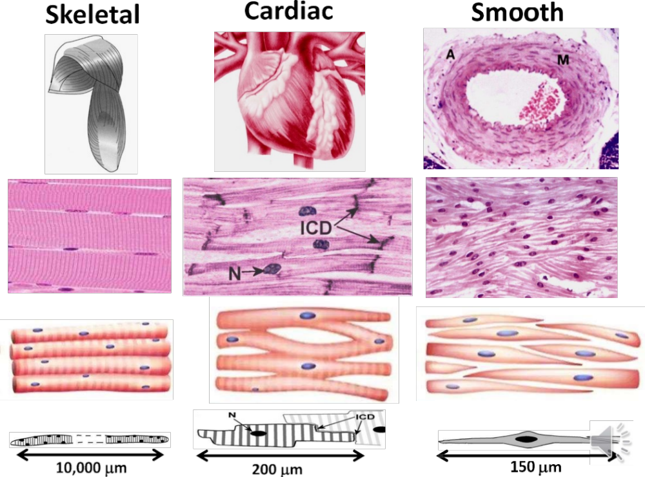
Types of Muscle

Slide 5
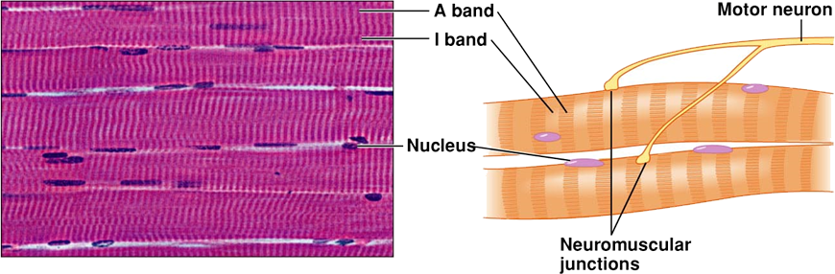
Skeletal Muscle
Striation (sarcomeres)
Effector of somatic nerve system
Voluntary contraction
Neuromuscular junction-specific
Multi-nuclei (fusion)
Notes:
Striation (Sarcomeres):
Muscle tissue is composed of repeating units called sarcomeres, which give skeletal muscles their characteristic striped appearance (striation).
Sarcomeres are the functional units of muscles, delimited by Z-discs. They consist of overlapping actin (thin) and myosin (thick) filaments, enabling muscle contraction.
Effector of Somatic Nervous System:
Skeletal muscles are the effectors of the somatic nervous system, which controls voluntary movements. It's under conscious control and responsible for activities like walking, talking, and typing.
Voluntary Contraction:
Contractions of skeletal muscles are typically under conscious control. When you decide to move a limb or perform an action, your brain sends signals via the somatic nervous system to stimulate the relevant muscles.
Neuromuscular Junction-Specific:
The neuromuscular junction is a specialized synapse where a motor neuron communicates with a muscle fiber. It's highly specialized for rapid and efficient transmission of nerve signals to initiate muscle contraction.
Multi-Nuclei (Fusion):
Skeletal muscle fibers are unique in that they are multinucleated, meaning they have multiple nuclei within a single cell. This is a result of the fusion of multiple precursor cells (myoblasts) during development.
This multi-nucleation contributes to the size and strength of skeletal muscles, as each nucleus can control a portion of the muscle fiber.

Slide 6
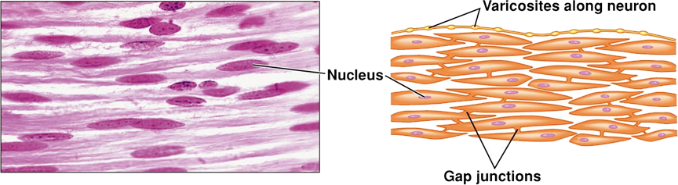
Smooth Muscle
No striation (filaments not form sarcomeres)
Effector of autonomic nerve system
Involuntary contraction
Varicosites-diffuse
Gap junctions
Notes:
No Striation (Filaments not Form Sarcomeres):
Smooth muscle lacks the distinct striations seen in skeletal muscle. Instead of organized sarcomeres, smooth muscle cells have actin and myosin filaments scattered throughout the cell, allowing for a more uniform, smooth appearance.
Effector of Autonomic Nervous System:
Smooth muscles are primarily regulated by the autonomic nervous system, which controls involuntary bodily functions. This includes activities like digestion, blood vessel constriction/dilation, and organ function.
Involuntary Contraction:
Contractions of smooth muscles are largely involuntary and not consciously controlled. They occur as a result of signals from the autonomic nervous system or local stimuli, such as changes in pH or stretching of the muscle tissue.
Varicosities - Diffuse:
The autonomic nervous system communicates with smooth muscle cells through varicosities, which are swollen, bead-like nerve endings. These varicosities release neurotransmitters in a more diffuse manner compared to the precise synaptic cleft seen in neuromuscular junctions of skeletal muscle.
Gap Junctions:
Smooth muscle cells are connected by gap junctions, which are specialized channels that allow for direct electrical and chemical communication between adjacent cells. This allows for coordinated contractions across a large area of smooth muscle tissue.

Slide 7
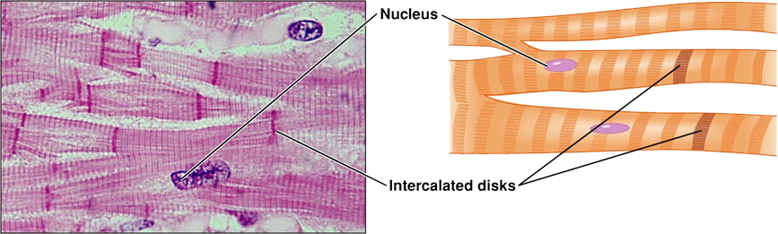
Cardiac Muscle
Striation (sarcomeres)
Effector of autonomic nerve system
Involuntary contraction
Gap junctions
Intercalated disks
Notes:
Striation (Sarcomeres):
Cardiac muscle, like skeletal muscle, also exhibits striations due to the organized arrangement of sarcomeres. Sarcomeres are the repeating units of contraction, composed of overlapping actin and myosin filaments.
Effector of Autonomic Nervous System:
The autonomic nervous system influences cardiac muscle activity. However, unlike smooth muscle, cardiac muscle has an intrinsic rhythm, and the autonomic system modulates rather than initiates the heartbeat. It helps adjust the rate and force of contractions in response to physiological needs.
Involuntary Contraction:
Cardiac muscle contractions are involuntary, meaning they occur without conscious control. The heartbeat is regulated by specialized cardiac conduction system cells that initiate and propagate electrical signals, leading to rhythmic contractions.
Gap Junctions:
Cardiac muscle cells are connected by specialized junctions called gap junctions. These channels allow for rapid electrical communication between adjacent cells, ensuring that the heart contracts as a coordinated unit.
Intercalated Disks:
Intercalated disks are unique structures found in cardiac muscle. They are specialized regions where adjacent cardiac muscle cells physically connect. Intercalated disks contain gap junctions and desmosomes, which provide both electrical continuity and mechanical stability to the tissue.

Slide 8
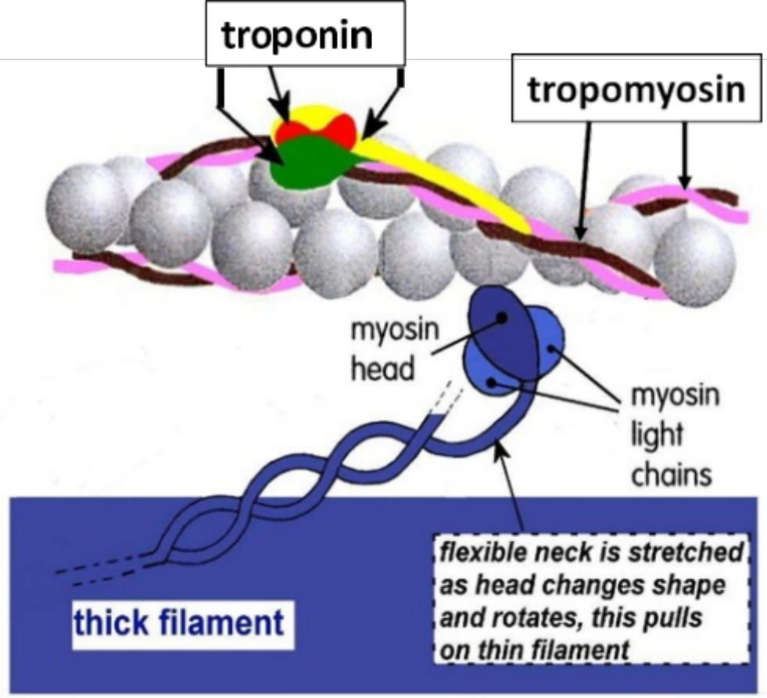
”On-off switch” – Skeletal and Cardiac
Interaction of actin and myosin depends on regulatory proteins on the thin filament:
  Tropomyosin – blocks myosin binding sides on actin
  Troponin C – binding site for Ca2+
  Troponin T – binds to tropomyosin
  Troponin I – binds to actin
Ca2+ binds to troponin-C then a conformational change occurs which moves tropomyosin
This then revelas the myosin binding site and a cross-bridge can form
Notes:
Tropomyosin:
Tropomyosin is a long, filamentous protein that lies along the groove of the actin filament. In its resting state, tropomyosin physically blocks the myosin binding sites on the actin filament.
When a muscle is at rest, tropomyosin acts as a regulatory "gatekeeper," preventing myosin heads from attaching to actin.
Troponin C:
Troponin is a complex protein consisting of three subunits: Troponin C, Troponin T, and Troponin I. Troponin C is the subunit that binds to calcium ions (Ca2+).
When calcium levels increase in the sarcoplasm (the fluid inside muscle cells), calcium ions bind to specific sites on Troponin C. This binding triggers a conformational change in the troponin complex.
Troponin T:
Troponin T is the subunit of troponin that binds to tropomyosin. When calcium ions bind to Troponin C, Troponin T undergoes a conformational change, which assists in moving tropomyosin away from the myosin binding sites on actin.
In essence, Troponin T helps facilitate the exposure of myosin binding sites on the actin filament.
Troponin I:
Troponin I is the subunit of troponin that binds to actin. When Troponin I binds to actin, it helps stabilize the position of the troponin-tropomyosin complex.
Additionally, Troponin I plays a crucial role in preventing unwanted muscle contractions by inhibiting the interaction between actin and myosin when calcium levels are low.

Slide 9
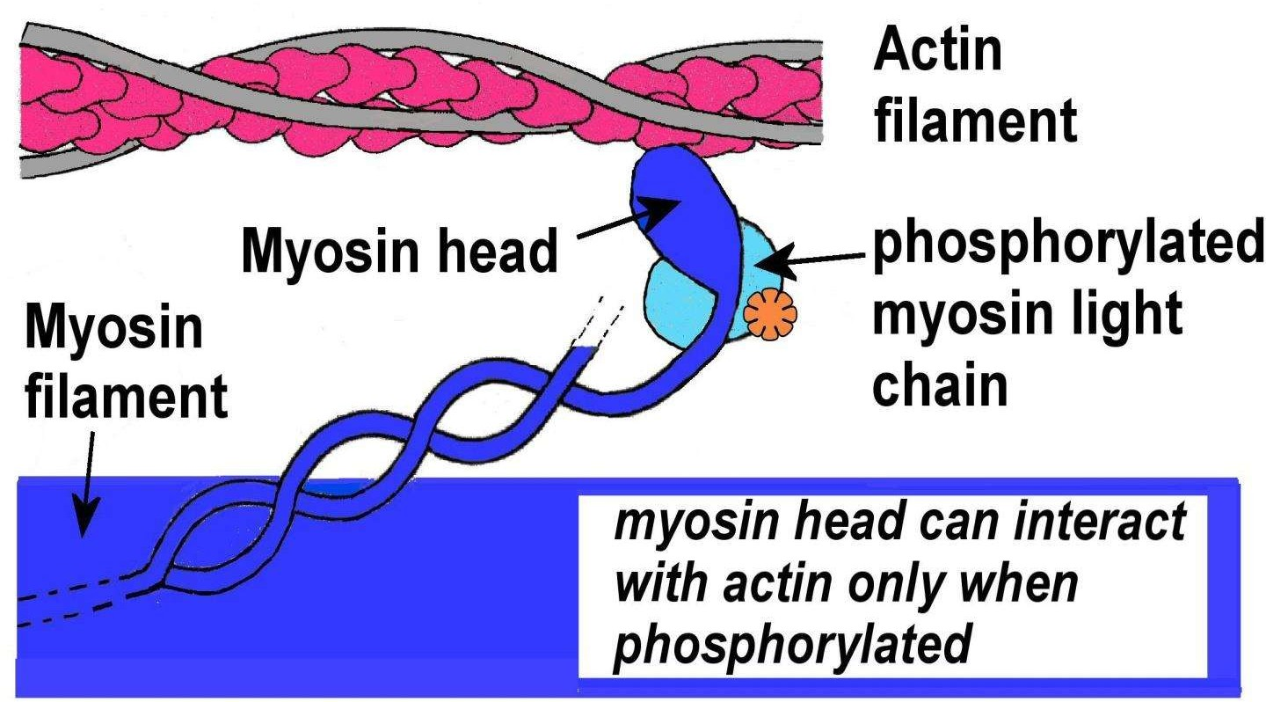
”On-off switch” – Smooth
Smooth muscle doesn’t contain troponin, therefore Ca2+ triggers contraction via different mechanism
Ca2+ binds to protein called calmodulin
Binds to myosin light chain kinase (MLCK)
Myosin light chains are then phosphorylated
This permits the binding of myosin to actin
Notes:
Phosphorylation is where phophsate group is added

Slide 10
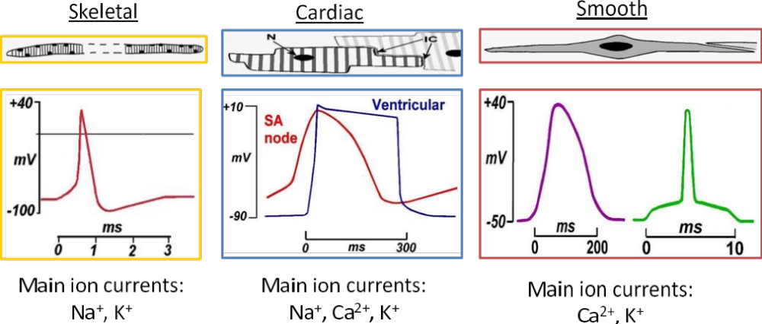
Depolarisation in different muscle
Skeletal – AP triggers release of calcium from SR
Cardiac and smooth – the AP and source of calcium differ
Notes:
Cardiac
Action Potential (AP): Cardiac muscle generates its own rhythmic action potentials due to specialized cells known as pacemaker cells. These cells, found in the sinoatrial (SA) node of the heart, spontaneously depolarize and initiate action potentials.
Source of Calcium: In cardiac muscle, extracellular calcium (Ca2+) influx through voltage-gated calcium channels in the cell membrane triggers the release of intracellular calcium from the sarcoplasmic reticulum (SR).
Smooth
Action Potential (AP): Unlike cardiac
Calcium:
Voltage-Gated Channels: In some types of smooth muscle, especially in the gastrointestinal tract, calcium influx through voltage-gated channels in the cell membrane plays a role in initiating contraction.
Receptor-Operated Channels: In many cases, calcium influx is primarily triggered by the activation of receptors on the cell membrane. These receptors can be stimulated by neurotransmitters, hormones, or changes in extracellular ion concentrations.
muscle, smooth muscle lacks a stable pacemaker system. It can be activated by various stimuli, such as neurotransmitters, hormones, or changes in mechanical stretch.

Slide 11
Twitch contraction
  Contraction produced in response to a single action potential
  All or nothing for a given muscle fibre
  Can be induced for a muscle fibre, a motor unit or a whole muscle
  Latency: time delay between stimulation (nerve AP or direct electrical) – E-C coupling
  Contraction phase – cross-bridge cycling
  Relaxation phase – Ca²⁺ uptake

Slide 12
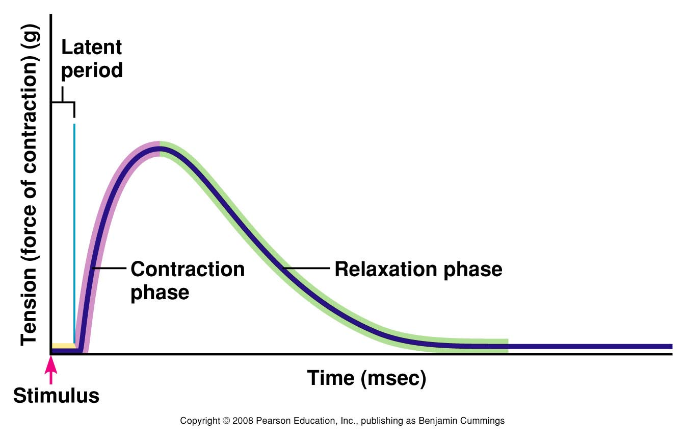
Twitch contraction
Notes:
Nervous Stimulation: A twitch occurs when a nerve impulse (action potential) stimulates a motor neuron, which in turn signals a specific muscle fiber to contract.
Phases of a Twitch:
Latent Phase: This is the brief moment between the nerve impulse and the onset of muscle contraction. It represents the time taken for the action potential to travel along the nerve and initiate the muscle response.
Contraction Phase: This is when the muscle fiber actively shortens and generates force.
Relaxation Phase: After the contraction, the muscle fiber returns to its original length, and tension decreases.
Strength and Duration: The strength and duration of a twitch are relatively constant and do not vary greatly under normal physiological conditions.

Slide 13
Frequency and Summation
  Action potential: 2 ms
  Contraction: 10–200 ms, possible to summate
  Tension (force) depends on [Ca²⁺]_{i}
  Freq. of stim.↑, Ca²⁺ release>uptake, [Ca²⁺]_{i}↑
  When the system is saturated (all troponin bind with Ca²⁺ and cross-bridge cycling maxed out) – tetanus (long lasting contraction)

Slide 14
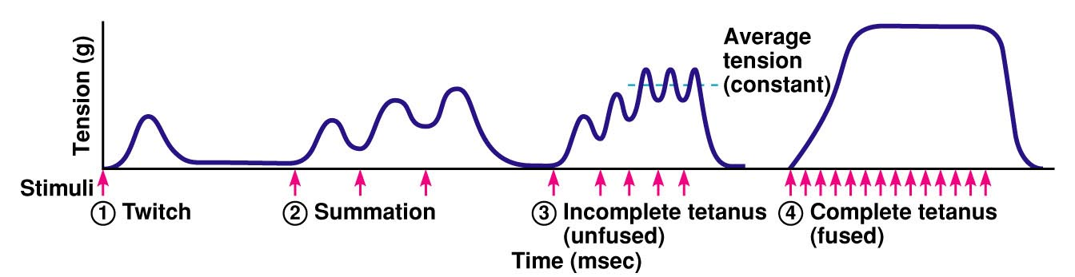
Frequency and Summation
Notes:
Summation and tetanus are processes by which muscle fibers can produce sustained contractions.
They occur when muscle fibers receive repeated nerve impulses in a short period of time.
Summation: This occurs when a single motor neuron repeatedly sends action potentials in quick succession to a muscle fiber. If the impulses are frequent enough, the muscle fiber doesn't have enough time to completely relax between contractions. As a result, the force of each contraction adds up, leading to a more sustained, stronger contraction.
Incomplete Tetanus: In this state, the muscle fiber is stimulated at a rapid rate, but there is still a partial relaxation between contractions. The result is a sustained but not entirely steady level of muscle tension.
Complete Tetanus (Fused Tetanus): When the stimulation frequency is so high that the muscle fiber doesn't have time to relax at all between contractions, a complete tetanus occurs. The contractions fuse together, resulting in a sustained, smooth, and maximal level of muscle tension.
Physiological Tetanus: This is a sustained muscle contraction that occurs during normal, everyday activities. It's the result of repeated motor neuron signaling to muscle fibers.
Pathological Tetanus: This is an uncontrolled, sustained muscle contraction often caused by the toxin produced by the bacterium Clostridium tetani. It leads to severe muscle rigidity.

Slide 15
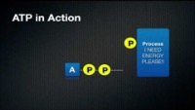
Energy Production - ATP
Notes:
Phosphorylation is where phophsate group is added

Slide 16
Energy Production - ATP
How does ATP provide energy?
Reaction (catabolic) -
ATP  ADP + P + Energy + Heat
Stores of ATP in body are sufficient for few seconds of maximal work.
Notes:
Phosphorylation is where phophsate group is added

Slide 17
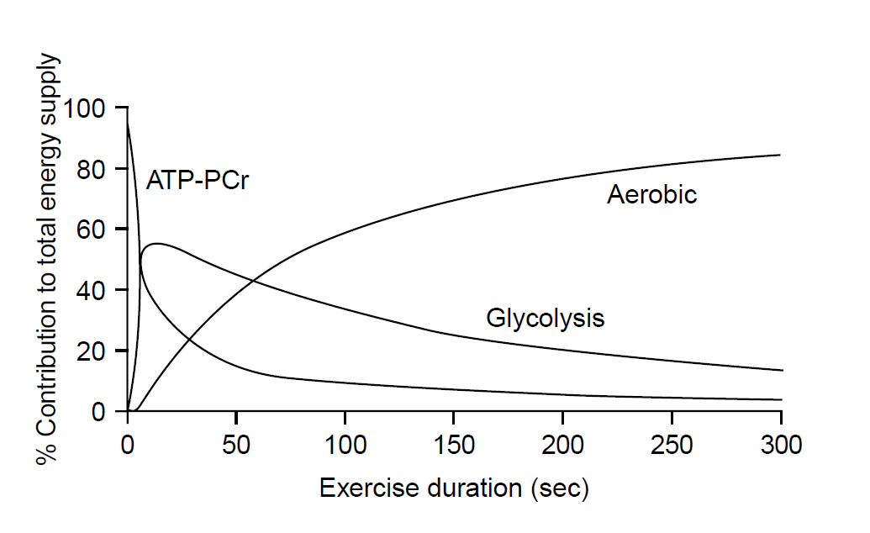
Energy Production – PCr System
PCr used as follows:
PCr  P + Cr + Energy
Facilitated by the enzyme creatine kinase
Energy released from catabolic PCr reaction
ADP + P + Energy  ATP
Anabolic reaction – phosphate and energy reform ATP
Notes:
Phosphorylation is where phophsate group is added

Slide 18
Energy Production – Glycolysis
10 enzyme-controlled reactions
Glycolysis ➔
breakdown of 6-carbon molecule - Glucose (C₆H₁₂O₆) ➔ two 3-carbon molecule of pyruvic acid (C₃H₆O₃)
Net gain of 2 ATP
All reactions are reversible
Notes:
Phosphorylation is where phophsate group is added

Slide 19
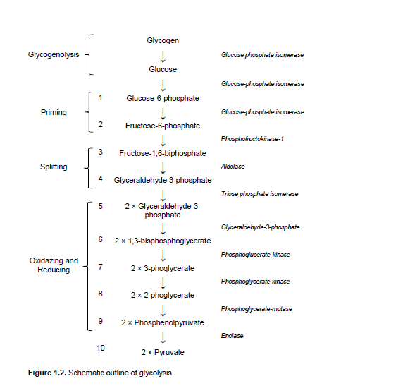
Energy Production – Glycolysis
“CHO”
10 Enzyme Controlled Reactions
ATP Synthesised
Pyruvate
No oxygen
Oxygen
Lactic acid
Krebs cycle
Notes:
Phosphorylation is where phophsate group is added

Slide 20
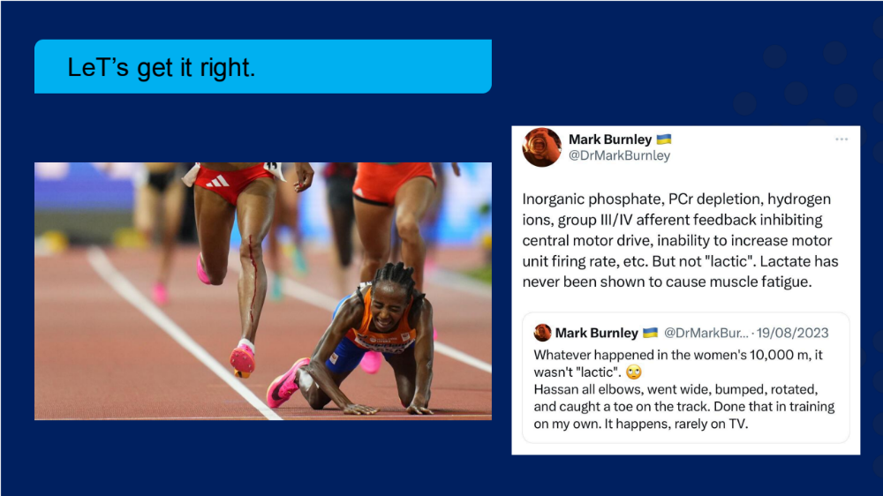
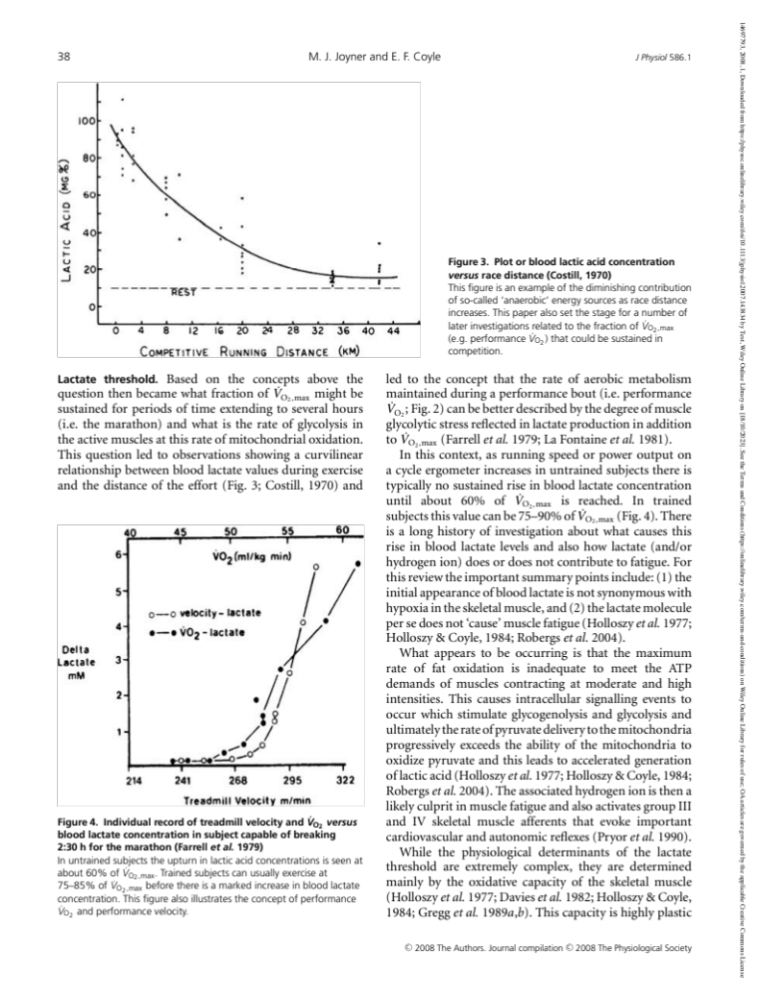
Just to get this right…
Notes:
The conversion of pyruvate to lactate results in the release of hydrogen ions (H+). These ions contribute to the increase in acidity (lower pH) in the muscle tissue and bloodstream, a condition known as acidosis.

Slide 21
Energy Production – Glycolysis
“CHO”
10 Enzyme Controlled Reactions
ATP Synthesised
Pyruvate
No oxygen
Oxygen
Lactic acid
Krebs cycle
Notes:
Phosphorylation is where phophsate group is added

Slide 22
Energy Production – Aerobic Pathways
Notes:
Phosphorylation is where phophsate group is added

Slide 23
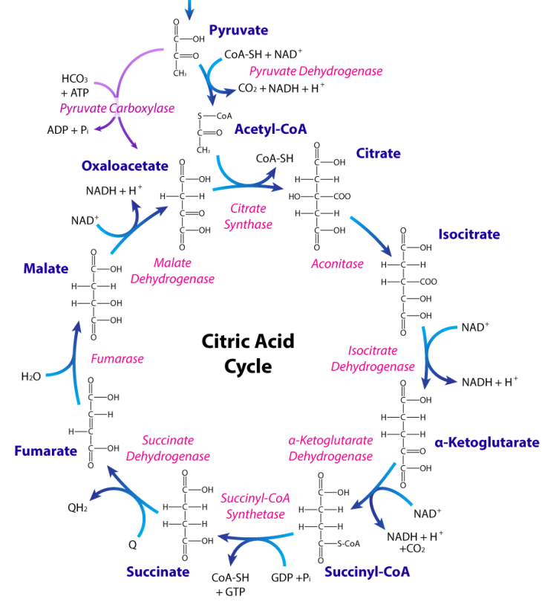
Energy Production – Aerobic Pathways
Krebs cycle (or citric acid cycle) consists of a series of reactions that result in a net production of (per molecule of glucose):
2 x ATP ( = 2 ATP from glycolysis) = 4 ATP
6 x NADH (+ 4 NADH from glycolysis) = 10 NADHs ≈ 30 ATP
2 x FADH₂ ≈ 4 ATP
38 ATPs produced from complete oxidation of glucose (Krebs and Electron Transport Chain)
Notes:
nicotinamide adenine dinucleotide (NAD+) is involved in the electron transport chain, a series of chemical reactions that occur within the mitochondria of cells. During the process of cellular respiration, NADH donates high-energy electrons to the electron transport chain, which in turn produces ATP.
flavin adenine dinucleotide is a molecule that accepts electrons during various metabolic reactions. When FAD accepts two electrons and two protons (H+ ions), it becomes reduced to FADH2.

Slide 24
Energy Production – Aerobic Pathways
Triglyceride
Glycerol
Enters glycolysis
Moved into Kreb’s cycle
H+ taken to electron transfer chain
Total energy production 15-19 ATP
Fatty acids
When not attached to glycerol called free fatty acids
Broken down by beta-oxidation
Acetyl coenzyme A is taken to Kreb's cycle
H+ taken to electron transfer chain
Each Fatty acid, 129 ATP
Glycerol
3x Fatty acid
Glycolysis
Acetyl Co-A
Krebs cycle
Krebs cycle
H+ ions
H+ ions
ETC
ETC
19 ATP
129 (x3) = 387 ATP
Notes:
nicotinamide adenine dinucleotide (NAD+) is involved in the electron transport chain, a series of chemical reactions that occur within the mitochondria of cells. During the process of cellular respiration, NADH donates high-energy electrons to the electron transport chain, which in turn produces ATP.
flavin adenine dinucleotide is a molecule that accepts electrons during various metabolic reactions. When FAD accepts two electrons and two protons (H+ ions), it becomes reduced to FADH2.

Slide 25
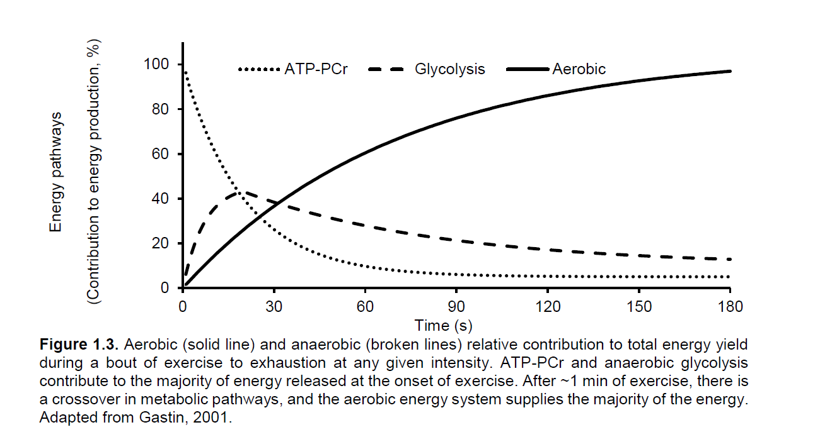
Energy Production – Systems
Notes:
nicotinamide adenine dinucleotide (NAD+) is involved in the electron transport chain, a series of chemical reactions that occur within the mitochondria of cells. During the process of cellular respiration, NADH donates high-energy electrons to the electron transport chain, which in turn produces ATP.
flavin adenine dinucleotide is a molecule that accepts electrons during various metabolic reactions. When FAD accepts two electrons and two protons (H+ ions), it becomes reduced to FADH2.

Slide 26
Summary
See learning outcomes.

